Slide 1
2024-2025 Mid-Winter meeting Kansas State Elks Youth Activities
Our Elk Duty to the Youth
The Future Elks of Tomorrow

Slide 2
Youth Protection Guidelines
Who should review this:
All Lodge Officers
All Committee Members
Any other Lodge Member, spouse or volunteer working with the youth on behalf of the Lodge
Can be located at: https://www.elks.org/grandlodge/manuals/
Code : 512200

Slide 3
Youth Protection Guidelines
Communications and Media: Communication between Adults and Youth; Personal Information & Use of Press and Social-Media
Media Coverage
Online Safety
Photography & Video: Investigation and Reporting of Incidents: Responding to Inappropriate Behavior; Reporting Requirements & Media Coverage of Incidents
Signed Forms::
Acknowledgement of Youth Protection Guide
Parental Consent and Medical Authorization
Parental Consent of Publication
Incident Report Form
Witness Statements
General Transportation Authorization.
Volunteer Selection and Screening: Interviews & Reference Checks;
Adult Youth Leader Requirements: Background Checks & Training
Youth Requirements: Medical Forms, Parental Consent & Privacy
Supervision and Care of Youth During Elks Youth Activities: Two-Adult Rule; Unplanned Situations with only One Adult; Four-Year-Older Rule; Hands Off Rule; Adult/Youth Ratio; One-on-One Contact; Mixed Youth Groups; Bullying and General Harassment; Hazing & Secret Ceremonies; Sexual Harassment; Sexual Assault; Sexual Exploitation; Stalking; Grooming; Sexual Activity and Public Displays of Affection; Use of Alcoholic beverages, tobacco, marijuana, and other substances; Prescription Medications; Verbal Interactions; Discipline & Counseling
Travel and Transportation: Parental Authorization; Overnight Events (Supervision; Facilities; Shower Times; Sleeping Arrangements; Proper Attire & Crisis Management Plan)

Slide 4
Elks National Youth Week (May 1st-7th)
Proclaim National Elks Week
Annual Youth Recognition
Governors of States, Lieutenant Governors, Mayors and other prominent elected officials should be asked to proclaim ELKS National Youth Week.
Lodge ER’s can seek similar proclamation or endorsement from Local Mayors of cities or communities.
Invite Community Leaders to youth gatherings
Recognize publicly local Youth Leaders
Focus on the kids & kid programs
Honor these young people with a banquet or some public program that school personnel, public officials or other groups interested in the youth recognition are asked to attend and participate.

Slide 5
Dictionary project
Founded in 1995 by Mary French to promote literacy to children in third-grade.
Over 15 million dictionaries have been distributed since 1995.
Elks started using the program in 2004.
Elks deliver dictionaries to local 3rd graders.
600 plus lodges across the country actively support this program
Sample Kits Available
There are two sample kits both have five books each and can be purchased for $15:
Provides all five of the American English language dictionaries.
Contains a dictionary and thesaurus usage guide, an English dictionary, an English-to-Spanish dictionary, an atlas, and a thesaurus.

Slide 6
Americanism essay contest
Promoting Patriotism among young people.
Eligible participants must be Students enrolled in 5th - 8th grade.
Essay length is not to exceed 300 words.
Essay must be typed or legibly printed in ink. Also, Essay must be submitted as written (or typed) by the entrant.
Essay must be submitted for judging to the Elks Lodge nearest to the address of the entrant.
Participant must be identified by name, grade, school attending and sponsoring Elks Lodge on the Essay.
Application packets can be downloaded at: https://www.elks.org/programs/americanism.cfm

Slide 7
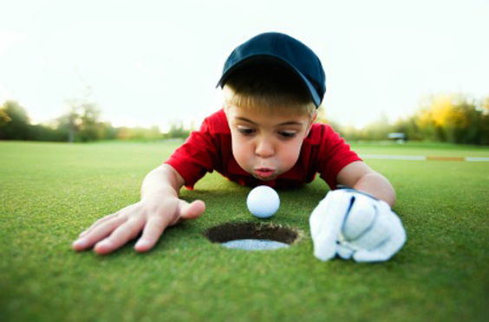
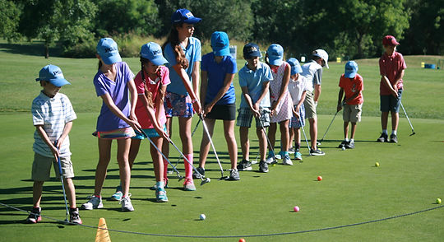
Jr. Golf program
Golf is becoming as popular among boys and girls as soccer
Sponsor a league, tournament, or a camp.
Invite a professional or trick-shot person to teach some skills.
Schedule a youth day at a driving range and rotate courses if possible.

Slide 8
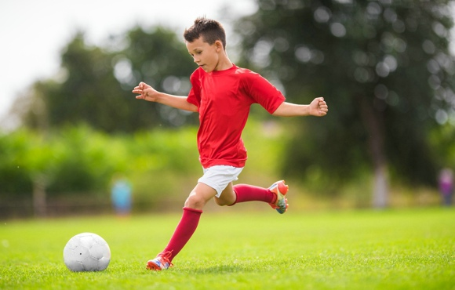
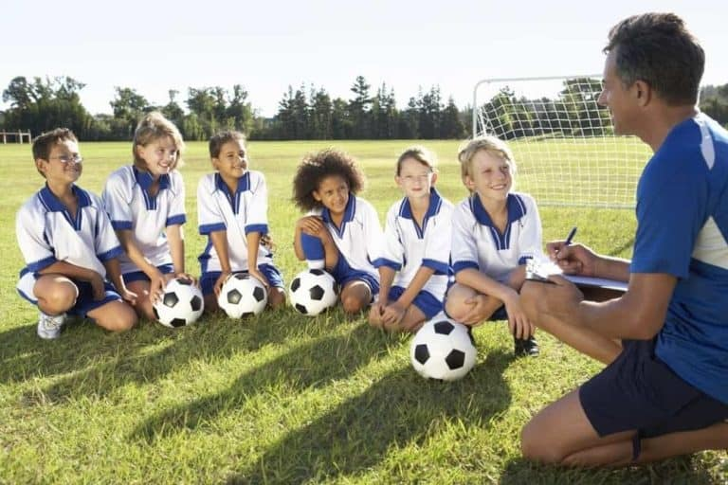
soccer Shoot
Soccer is one of the fastest growing youth activities in the country.
Soccer Shoot is a contest for Boys and Girls ages 14 & under.
Five Goals U-8 (48” – 17” Goals)
Grid Goal Contest
Set up at a local park, or local YMCA, contact local soccer clubs and local schools.
Local, State, and Regional Competitions. Working on a National Competition.
Chairman: Loren Anthony

Slide 9
Hoop Shoot
Hoop Shoot is a free throw contest for Boys and Girls ages 8 – 13. Team up with your schools, local YMCA or club basketball teams.
Local, District, State, Regional and National Competitions
Chairman:Tony Nash

Slide 10
Antlers Program
Elks Youth Group for our families that are members.
Boys or girls aged 12 – 20 years old. They hold monthly meetings and perform community service in and out of the lodge.
The Antlers of the Benevolent and Protective Order of Elks of the United States of America has as its major objective the following:
- To quicken the spirit of American Patriotism
- To teach respect for parents and love of home
- To inculcate the fundamentals of good citizenship
- To aid in a worthy cause
- To establish foundation of character
- To promote the welfare and enhance the happiness of its Members
- And to respect the conviction of others in the matters of worship and religion is true Americanism

Slide 11
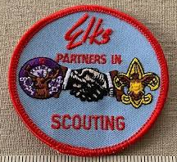
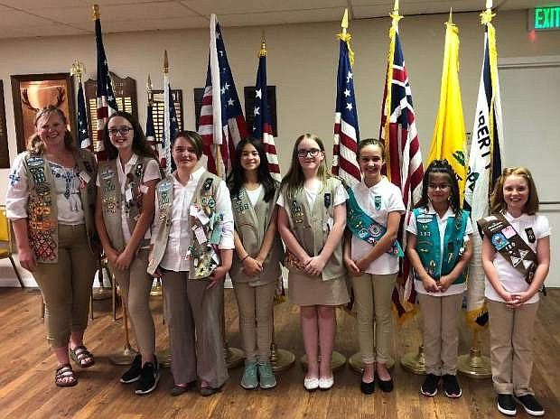
Boy Scouts
Girl Scouts
Eagle Scout recognition is a year-round program
Present American Flag, G.E.R. Letter and Certificate from Grand Lodge
Girl Scout Award certificates for Silver and Gold
Make the presentation in the Spring during Youth Week Recognition Program

Slide 12
Marvin M. Lewis Award
Recognizes Elks in good standing who have contributed significantly to the youth of their communities by volunteering in the programs of the Boy Scouts of America.
Contact Person:
Grand Lodge Activities Committee Member
David C. Foster – Pratt, KS Lodge # 1451

Slide 13
Student or Teenager of the Month/Year
Publicize the program by talking to your local schools
Traditional mail
Email
Phone
Face to Face
Set standards with the school for nominating students
We are recognizing the student/teen for their achievements in school and community life.

Slide 14
Junior reserve officers’ training corps. (J.R.O.T.C) RECOGNITION program
Program started in 2018
It is a Yearly Recognition; Monthly Cadet recognitions can be optional in highly active areas
Contact the Senior Instructor of the Program per location
Form a relationship with the instructors & Cadets
The Cadet chosen for the Cadet of the Year will receive this Medal and Ribbon. Metal presentation completed during the Elks National Youth Week.

Slide 15
j.r.o.t.c Recognition program
J.R.O.T.C. Programs
J.R.O.T.C. – Army
N.J.R.O.T.C. – Navy
M.C.J.R.O.T.C. – Marine Corp
A.F.J.R.O.T.C. – Air Force
S.F.J.R.O.T.C. – Space Force
C.G.J.R.O.T.C. – Coast Guard

Slide 16
j.r.o.t.c. Recognition program
Army J.R.O.T.C. Programs in Kansas
(as of 4/2024)
Garden City H.S
Leavenworth H.S.
Topeka West H.S.
Junction City H.S.
Liberal H.S.
Wichita Northwest H.S.
Wichita South H.S.
Wichita West H.S.
Wichita North H.S.
Wichita Southeast H.S.

Slide 17
j.r.o.t.c. Recognition program
Navy J.R.O.T.C. Programs in Kansas
Shawnee Mission North H.S.

Slide 18
j.r.o.t.c. Recognition program
Air Force J.R.O.T.C. Programs in Kansas
(as of 8/2024)
Dodge City H.S.
Lyons H.S.
Wichita Heights H.S.
Wichita East H.S.
Derby H.S.
Washburn Rural H.S.
Highland Park H.S.
Washington High School.

Slide 19
j.r.o.t.c. Recognition program
Marine Corps J.R.O.T.C. Programs in Kansas
(as of 8/2024)
Northeast Magnet H.S.
Topeka H.S.

Slide 20
New Ideas for the next generation
We must always think of new ways to get the youth involved.
Here are a few to start a conversation in your Lodge:
Scavenger Hunt: Use the GooseHunt App or something similar.
Trivia Night: Use Kahoot.com
Have a “Night Club” / Youth Dance once a month.
Have a “Game Night” (Video Games).
Hold amateur talent night for Boys and Girls
Sponsor Youth Activity Teams.
Swimming, Little League Baseball, Bowling, etc.
Try anything that works in your community.

Slide 21
Youth Activities Programs Manual
Can be located at: https://www.elks.org/grandlodge/manuals/
Code : 512100

Slide 22
Contacts
State Youth Activities Chairperson
Nathan J. Ball
785-248-6444 Cell
Ballclan4@gmail.com
Area 6 Grand Lodge Committee Member
David C. Foster
620-770-0284 Cell
dcwhitail72@hotmail.com
THANK YOU !

Slide 23
A Little about me
ER for Ottawa Lodge #803
Assistant Chaplin for KEA
50 years old
Married for 31 years
Two married children: 26 & 28
One Granddaughter 7 mo.
Hobbies: Gardening, fishing, hunting, Harley riding, reloading and family time.

